Slide 1
Transform data with Azure Data Factory or Azure Synapse Pipelines
Subtitle Goes Here
Notes:
Instructor notes and guidance.
If you have taught DP-200, Implementing an Azure Data Solution, this module will be familiar as it uses content from module 7 of that course to teach Azure Data Factory/Azure Synapse Analytics Pipelines. There are new labs for the students to explore, and we have provided examples of how to deal with “dirty data sources” to provide a contrived example of dealing with data sources. The first part of this modules should be focused on the components of Azure Data factory. In fact, you could run this two-minute animation on this page as an introduction to the components before you go deeper with the learning:
https://docs.microsoft.com/en-us/learn/modules/intro-to-azure-data-factory/
The second part of the module explores Mapping Data Flow. Our recommendation is that you show a small example that incorporates the following
How to start the mapping data flow
How to add a source
How to add 1 transformation
How to add a sink
Beyond that, explain to the students that they will learn more by using it in the lab. As a result, we have provided two mapping data flow examples in the lab for them to explore.

Slide 2
Agenda
Data integration with Azure Data Factory or Azure Synapse Pipelines
Code-free transformation at scale with Azure Data Factory or Azure Synapse Pipelines
Notes:
TALKING POINTS
Let’s set an agenda for today’s presentation in which we are going to discuss the following:
Data integration with Azure Data Factory or Azure Synapse Pipelines
Code-free transformation at scale with Azure Data Factory or Azure Synapse Pipelines
PRESENTER NOTES AND GUIDANCE
Don’t take too much time in order to present the agenda. Make the points in the topics.

Slide 3
Data integration with Azure Data Factory or Azure Synapse Pipelines
1
Subtitle Goes Here
Notes:
TALKING POINTS
Let’s go over data integration with Azure Data Factory or Azure Synapse Pipelines.
PRESENTER NOTES AND GUIDANCE
N/A.

Slide 4




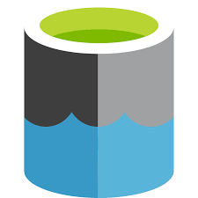


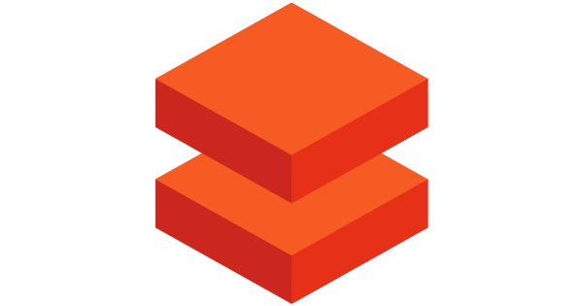
Data integration with ADF or Synapse Pipelines
@
Triggers
Parameters
Linked Service
IR
Integration
Runtime
CF
Control
Flow
Pipeline
Data Lake Store
1
Activities
Azure Databricks
Dataset
Notes:
Talking points
Let’s have a closer look at the components of Azure Data Factory
Linked services
Linked services are much like connection strings, which define the connection information that's needed for Data Factory to connect to external resources. Think of it this way: a linked service defines the connection to the data source, and a dataset represents the structure of the data. For example, an Azure Storage-linked service specifies a connection string to connect to the Azure Storage account. Additionally, an Azure blob dataset specifies the blob container and the folder that contains the data.
Linked services are used for two purposes in Data Factory:
To represent a data store that includes, but isn't limited to, an on-premises SQL Server database, Oracle database, file share, or Azure blob storage account. For a list of supported data stores, see the copy activity article.
To represent a compute resource that can host the execution of an activity. For example, the HDInsight Hive activity runs on an HDInsight Hadoop cluster. For a list of transformation activities and supported compute environments, see the transform data article.
Datasets
Datasets represent data structures within the data stores, which simply point to or reference the data you want to use in your activities as inputs or outputs.
Activity
Activities represent a processing step in a pipeline. For example, you might use a copy activity to copy data from one data store to another data store. Similarly, you might use a Hive activity, which runs a Hive query on an Azure HDInsight cluster, to transform or analyze your data. Data Factory supports three types of activities: data movement activities, data transformation activities, and control activities.
Pipeline
A data factory might have one or more pipelines. A pipeline is a logical grouping of activities that performs a unit of work. Together, the activities in a pipeline perform a task. For example, a pipeline can contain a group of activities that ingests data from an Azure blob, and then runs a Hive query on an HDInsight cluster to partition the data.
The benefit of this is that the pipeline allows you to manage the activities as a set instead of managing each one individually. The activities in a pipeline can be chained together to operate sequentially, or they can operate independently in parallel.
Triggers
Triggers represent the unit of processing that determines when a pipeline execution needs to be kicked off. There are different types of triggers for different types of events.
Pipeline runs
A pipeline run is an instance of the pipeline execution. Pipeline runs are typically instantiated by passing the arguments to the parameters that are defined in pipelines. The arguments can be passed manually or within the trigger definition.
Parameters
Parameters are key-value pairs of read-only configuration. Parameters are defined in the pipeline. The arguments for the defined parameters are passed during execution from the run context that was created by a trigger or a pipeline that was executed manually. Activities within the pipeline consume the parameter values.
A dataset is a strongly typed parameter and a reusable/referenceable entity. An activity can reference datasets and can consume the properties that are defined in the dataset definition.
A linked service is also a strongly typed parameter that contains the connection information to either a data store or a compute environment. It is also a reusable/referenceable entity.
Control flow
Control flow is an orchestration of pipeline activities that includes chaining activities in a sequence, branching, defining parameters at the pipeline level, and passing arguments while invoking the pipeline on-demand or from a trigger. It also includes custom-state passing and looping containers, that is, For-each iterators.
Integration Runtime
Integration Runtime is referenced by the linked service or activity, and provides the compute environment where the activity either runs on or gets dispatched from. Data Factory offers three types of Integration Runtime, and you should choose the type that best serve the data integration capabilities and network environment needs you are looking for. These three types are:
Azure - Copying between two cloud data sources:
Self-hosted - Copying between a cloud data source and a data source in private network
Azure-SSIS - Copying between two data sources in private network (only supported in Azure Data Factory, not Azure Synapse Pipelines)
Instructor notes and guidance.
This slide is a build slide, please make sure that you are familiar with the order that the items appear.
Click 1 – Enable you to speak about Linked Services:
Click 2 – Use Data Lake Store as a storage resource example
Click 3 – Use Databricks as a compute resource example
Click 4 – Enables you to talk about the Dataset object
Click 5 – this is a graphic to show a flow of data
Click 6 – Bring up the word activity
Click 7 – shows a rotating cog to reflect a single activity
Click 8 – removes the word activity
Click 9 - shows multiple rotating cogs to reflect multiple activities
Click 10 – Shows a funnel with the word pipeline to show that activities are grouped into a pipeline.
Click 11 – The word trigger appears with a circular arrow
Click 12 – The circular arrow rotates to indicate that a pipeline is triggered to execute
Click 13 - nothing happens
Click 14 – a number 1 appears out of the data and flows through the pipeline into the data set to reflect data being transformed by the activities in a pipeline
Click 15 - The word Parameters with an @ symbol appears
Click 16 – The word Integration runtime appears with an IR icon
Click 17 - The word Control Flow appears with the CF icon
Recommended reading for this slide
Data integration with Azure Data Factory - Learn | Microsoft Docs

Slide 5
Code-free transformations at scale with ADF and Synapse Pipelines
2
Subtitle Goes Here
Notes:
Talking Points:
Let’s look at how you can do code-free transformations at scale using Azure Data Factory or Synapse Pipelines.

Slide 6
ETL versus ELT
Cloud adoption is shifting processing from ETL to ELT
Extract, Transform, and Load
Extract, Load, and Transform
Transformation work takes place in a specialized engine.
Often involves using staging tables to hold data as it is being transformed.
Transformed data is loaded into destination.
Data is copied into a data lake before transformations are applied.
Transformations are handled after the data has landed in a data lake.
Simplifies architectures by removing the transformation engine from the pipeline.
Scaling the target data store also scales the ELT pipeline performance.
Notes:
Extract, transform, and load (ETL) is a data pipeline used to collect data from various sources, transform the data according to business rules, and load it into a destination data store. The transformation work in ETL takes place in a specialized engine, and often involves using staging tables to temporarily hold data as it is being transformed and ultimately loaded to its destination.
ELT differs solely in where the transformation takes place, but there are implications for this which often make it a better choice for modern data warehouses hosted in the cloud.
In both cases, the data transformation that takes place usually involves various operations, such as filtering, sorting, aggregating, joining data, cleaning data, deduplicating, and validating data.
ELT is the approach being used more often in the cloud because it is considered more important to copy data into a centralized data store, such as a data lake, quickly and then handle transformations once the data has landed in the data lake.
This simplifies the architecture by removing the transformation engine from the pipeline. Another benefit to this approach is that scaling the target data store also scales the ELT pipeline performance.

Slide 7
What are Mapping data flows?
Visually designed data transformations in ADF/Synapse Pipelines
Allow data engineers to developing transformation logic without writing code
Executed as activities in a pipeline
Notes:
Let’s dive into Mapping data flows
Mapping data flows are visually designed data transformations in Azure Data Factory or Azure Synapse Pipelines.
Data flows allow data engineers to develop graphical data transformation logic without writing code.
The resulting data flows are executed as activities within Azure Data Factory pipelines that use scaled-out Spark clusters.
Data flow activities can be operationalized via existing Data Factory scheduling, control, flow, and monitoring capabilities. Mapping data flows provide a fully visual experience with no coding required.
Your data flows will run on your own execution cluster for scaled-out data processing. Azure Data Factory handles all the code translation, path optimization, and execution of your data flow jobs.
Data Flow mapping brings the following benefits and capabilities:
- Perform data cleansing, transformation, aggregations, etc.
- Enables you to build resilient data flows in a code free environment
- Enable you to focus on building business logic and data transformation
- Underlying infrastructure is provisioned automatically with cloud scale via Spark execution

Slide 8
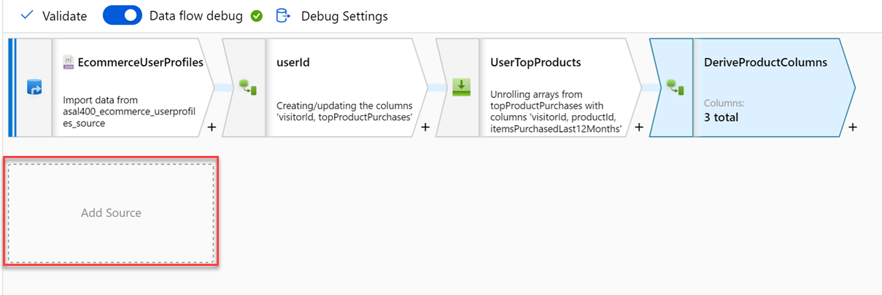
Code-free transformations at scale with ADF or Synapse Pipelines
Notes:
Talking points
Like many data transformation tools, Mapping Data Flow in Azure Data factory supports a great variety of data transformations.
Talk about various transformation options:
Aggregations
Joins
Derived columns
Flatten
Filter
Etc.
Instructor notes and guidance.
Note that this content is valid for both Azure Data Factory and Azure Synapse Pipelines. Consider showing an example through a demo, you should consider replaying some of the activities done in the lab. The feedback from MCTs about DP200 is that many students needed help the ADF lab, so replaying the mapping data flow should be considered
Recommended reading for this slide
https://docs.microsoft.com/en-us/azure/data-factory/data-flow-transformation-overview
Code-free transformation at scale with Azure Data Factory - Learn | Microsoft Docs

Slide 9
LAB: Transform data with Azure Data Factory or Azure Synapse Pipelines
60 minutes
Notes:
TALKING POINTS​
​
Let’s put this into reality and show you how it works.​
​This lab teaches students how to build data integration pipelines to ingest data from multiple data sources, transform data using mapping data flows and notebooks, and perform data movement into one or more data sinks.
In exercise 1. the students will create the required objects; namely SQL tables, that will be used to store the data that is ingested by the mapping data flow. Then they will define the required linked services to connect to the data sources to consume the data, followed by pointing to the datasets within the linked services. Note that the students will be dealing with a poorly formatted data while creating these datasets, and how to handle it in a linked service.
In exercise 2, and exercise 3, the students will use a Mapping Data Flow to create a campaign analytics data pipeline, and the top product purchases respectively. This gives the students a couple of examples of how the Mapping data flow can be used to transform data using Azure Data Factory/Azure Synapse pipelines.
In exercise 4, the students will trigger the execution of their work, and learn how they can monitor the execution of the pipelines that they have created.

Slide 10
Build data analytics solutions using Azure Synapse serverless SQL pools - Learn | Microsoft Docs
Notes:
TALKING POINTS​
​
This slide links to our content on Microsoft Learn

